Slide 1



Building real time voice agents on Azure AI
aMP Bengaluru
27/09/2025
Asha Holla

Slide 2





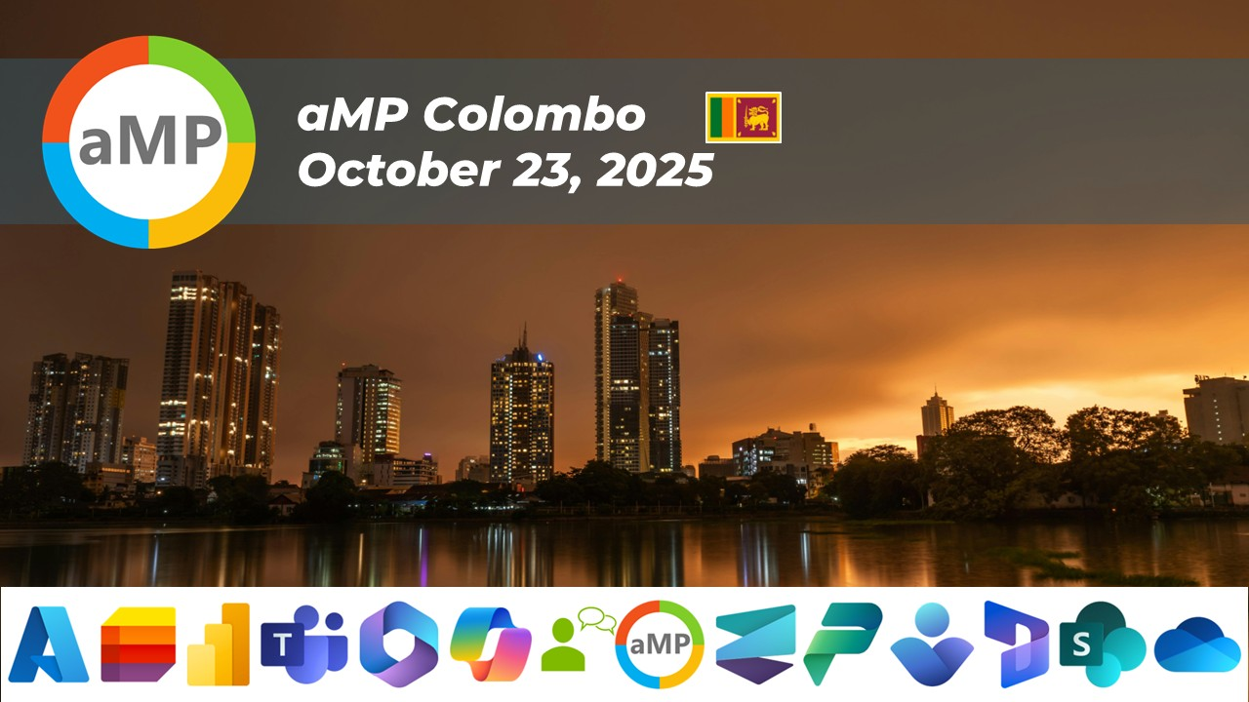


Upcoming aMP Events – 2nd Half of 2025

Slide 3

Who am I?
Asha Holla
Data Engineer at Bloom Value
Speaker - Blogger

Slide 4
For the next hour
Demo sneak peek
Why voice agents are the future
Voice agent usecases
Speech to Speech pipeline
Offerings on Azure for building STS pieplines
Batching vs streaming
Challenges

Slide 5
Why voice is the future of AI
Communication is multimodal – not just limited to text
Voice is the most natural interface
IVR is broken – 75% customers try to skip menus if possible

Slide 6
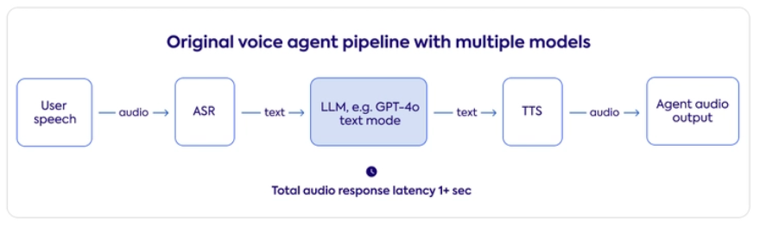
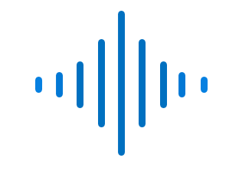

Simplified voice agent pipeline
Minimum 3 API calls
Core loop - Listen → Understand → Decide → Speak

Slide 7
Simplified voice agent pipeline - components
STT - converts spoken audio into text.
Foundation model - Understands the text and decides how to respond.
TTS- Converts the agent's reply back to speech.
VAD voice activity detection - Helps detect when a user starts/stops speaking.
Interrupt Handler - Stops responses if the user interrupts.

Slide 8
Two ways to do it
Aspect | Batch Mode | Streaming Mode
Workflow | Collect full audio → Transcribe → LLM → TTS → Play back | Process audio chunks as they arrive → Transcribe partials → Stream LLM tokens → Stream TTS
User Experience | Noticeable pauses, walkie-talkie feel | Smooth, conversational flow, near real-time
Latency | High (waits for full sentences) | Low (responses overlap with input)
Interactivity | One-turn at a time, user must wait | Continuous, natural interruptions and back-and-forth
Technical Simplicity | Easy to implement (sequential pipeline) | Harder (requires async, WebSockets, threadingg)
Best for | Offline transcription, note-taking, meeting summaries | Live agents, customer calls, interactive assistants

Slide 9
Some nuances to keep in mind
Listening & Processing in Parallel - ASR starts transcribing *while* the user is still speaking.
* The LLM streams partial tokens as they are generated.
* The agent can “start speaking back” even before the answer is fully ready.
* TTS begins as soon as the first words are available.
* Playback overlaps with transcription + LLM inference.
* Streaming enables mid-response interruption.
* Stream: Even if total compute time is the same, *user feels it as instant* because feedback starts early.
Notes:
Token-by-Token Response Generation**
Overlapping Speech & Output**
Interrupt Handling (“Barge-in”)**
* The user can talk over the bot, and the system adapts in real time.
Perception of Latency vs Actual Latency**

Slide 10
Flow visualized
User Action | Recognizer Event / Callback | Thread A (AI / stream_ai_response) | Queue (tts_queue) | Thread B (TTS Worker)
Speaks | recognizing_cb
 | recognized_cb |  | filler → Q | TTS speaks filler
 |  | stream_ai_response() | sentence → Q | TTS speaks Gujarat sentence
Interrupts | recognizing_cb → stop_speaking_if_needed() | breaks AI streaming loop | Queue cleared, TTS stops | Playback stops immediately
New speech | recognized_cb |  | new filler → Q | TTS speaks new filler
 |  | stream_ai_response() | Bengal → Q | TTS speaks Bengal response
Notes:
Token-by-Token Response Generation**
Overlapping Speech & Output**
Interrupt Handling (“Barge-in”)**
* The user can talk over the bot, and the system adapts in real time.
Perception of Latency vs Actual Latency**

Slide 11
On Azure
Azure AI Foundry – LLM model deployment/ management
Azure Open AI – for OpenAI GPT models
Azure Speech Services
Copilot Studio – low code development platform
Azure Communication Services – ACS – telephony, SMS interaction w voice agents
Azure App Service – hosting code

Slide 12
Realtime API
ASR/STT is handled
Threading/ queue management for streaming is handled
Have to still integrate TTS
Less flexibility and low complexity
Latency low but cost high
For implementation
github.com/run-llama/openai_realtime_client
github.com/jhakulin/realtime-ai
github.com/Azure-Samples/aoai-realtime-audio-sdk/tree/main

Slide 13
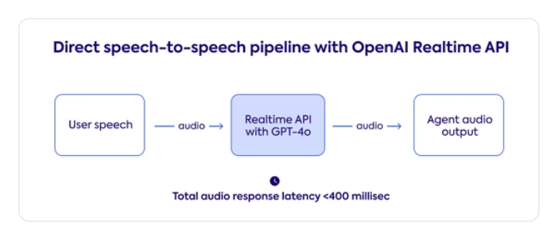
Realtime API

Slide 14
Lessons/challenges
Echo suppression during playback
Stt and tts handling with Azure speech service
Deployment challenges with Azure Communication services

Slide 15

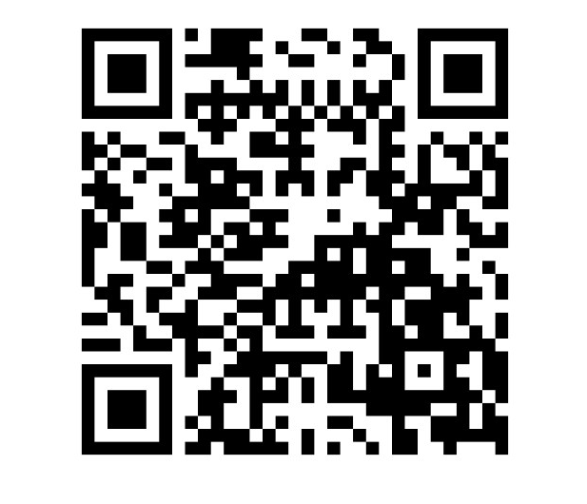
Thank You

